Slide 1

HackerRank Re-Design
Team: Sunit Bail
Pooja Vaikos
Vennela Karaddi
Harshil Patel
Aishwarya Patil

Slide 2
Agenda
Product Objectives
Functional Requirements
Target audience
Usability Testing
Color Scheme
User Needs
Onboarding
Summary
UX Research Methods
Demo
Information Architecture

Slide 3
Product Objectives

Slide 4
Product Objectives
Simplified Navigation
Social Community
Increased user-base
Simplified Sign up
Efficient Filtering

Slide 5
Target Audience and User Segmentation

Slide 6
Target Audience
Our target audience has following attributes
Age - 14 to 40 years
Familiar with computer and browsing
Basic knowledge of code
Using above attributes we designed our website to focus more on the coding platform with minimal instructions on how to navigate through which anyone familiar web browsing will be able.

Slide 7
User Segmentation
We are primarily segmenting our users based on demographic properties
Education
Occupation
We offer different services for users based on their role which primarily reflects their occupation
Professor - To conduct quizzes and assessments
Recruiter (Companies) - For hiring process
Developer - To learn coding and other skills

Slide 8
User Needs

Slide 9






User Needs
Developers
Recruiters

Slide 10
Onboarding

Slide 11
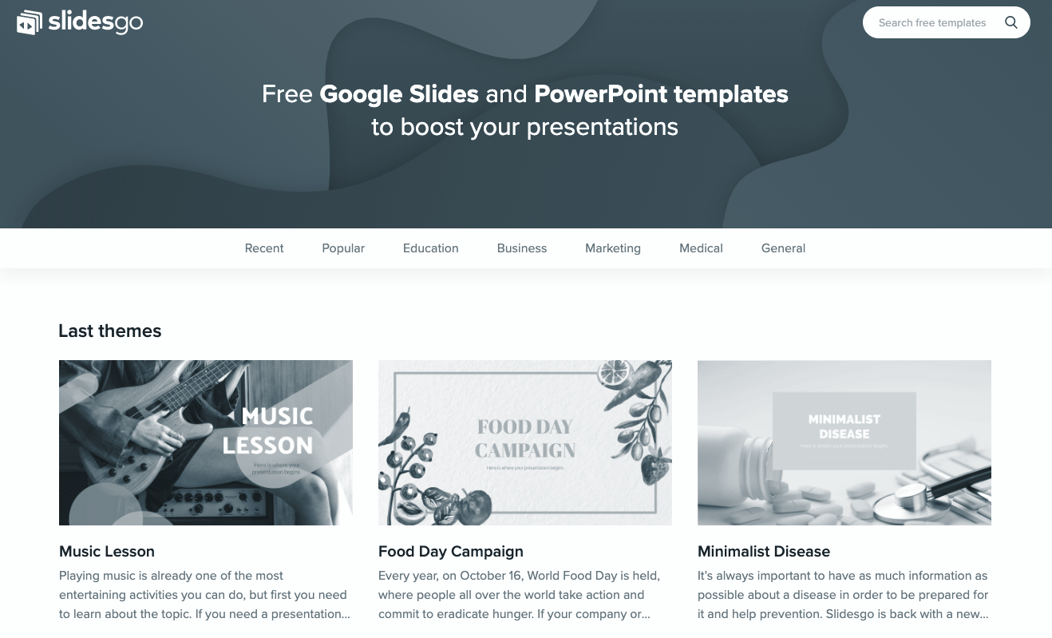
User Onboarding
Type of onboarding:
Interactive Onboarding

Slide 12
UX Research Methods

Slide 13
UX Research Method
System Usability Scale
Parallel Design
Personas

Slide 14
Personas

Slide 15

Persona 1
About Jack
Jack is an undergrad computer engineering student who is looking to pick up new skills to get a internship. He is looking for resources to build his profile at his own pace so he could manage his academics as well as job search.
Goals
To become an efficient back-end software developer
To be certified in a relevant technology
Frustrations
To look at a hundred websites to learn a skill
To manage time between classes and self-learning skills
Tech
Internet
Online Shopping
Social Media
Jack Doe
Occupation: Student
Age: 22 years
Location: Illinois, Chicago
Family: Unmarried
“I want to be a problem-solver. I want to practice coding challenges and get certified so I can get my dream job.”

Slide 16
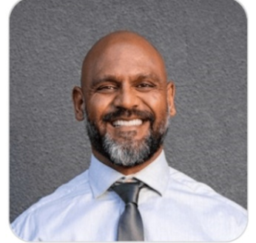
Persona 2
About Michael
Michael is a senior software developer who is looking forward to a more challenging role at an organisation. He is expecting a better compensation for his next job to support his family.
Goals
To keep up with new technologies and the interview trends
To find the job that matches his profile and expectations
Frustrations
Visiting multiple websites to send a job application and wait for the coding challenge/next step of the process
Tech
Internet
Online Shopping
Social Media
Michael Levinson
Occupation: Senior Software Engineer
Age: 37 years
Location: Seattle, Washington
Family: Married, two children
“I’m looking to switch my job and I need to brush my skills and apply for jobs.”

Slide 17
Information Architecture

Slide 18
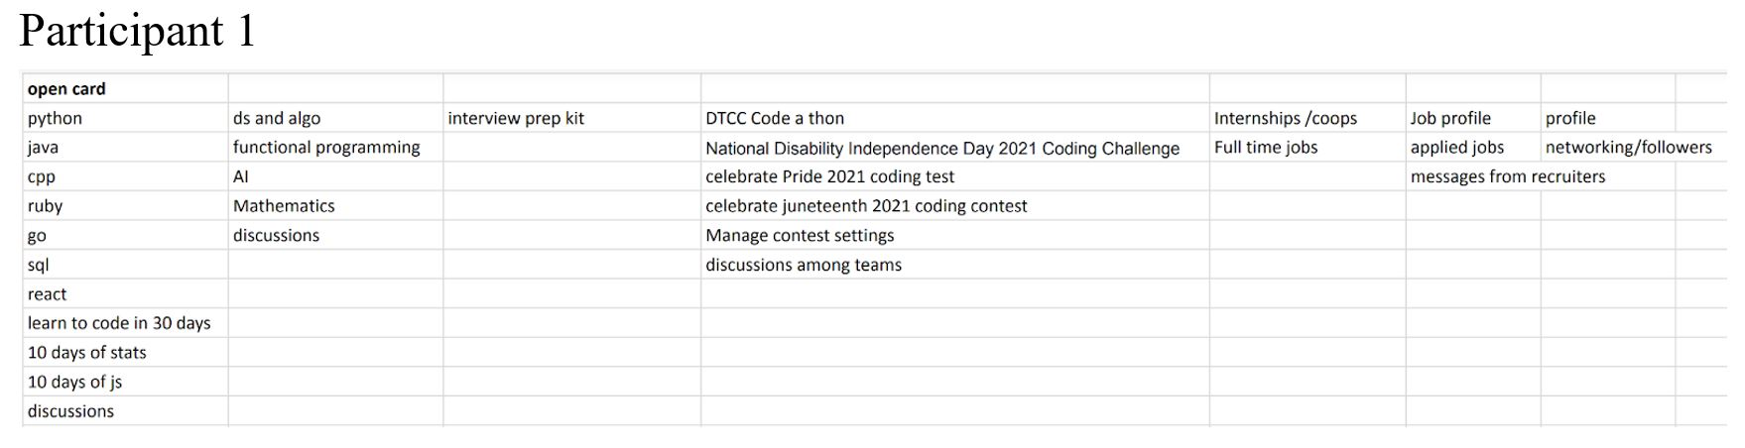
Open Card Sorting
We understand user expectations
Complex to interpret with multiple users
Flexibility to users

Slide 19
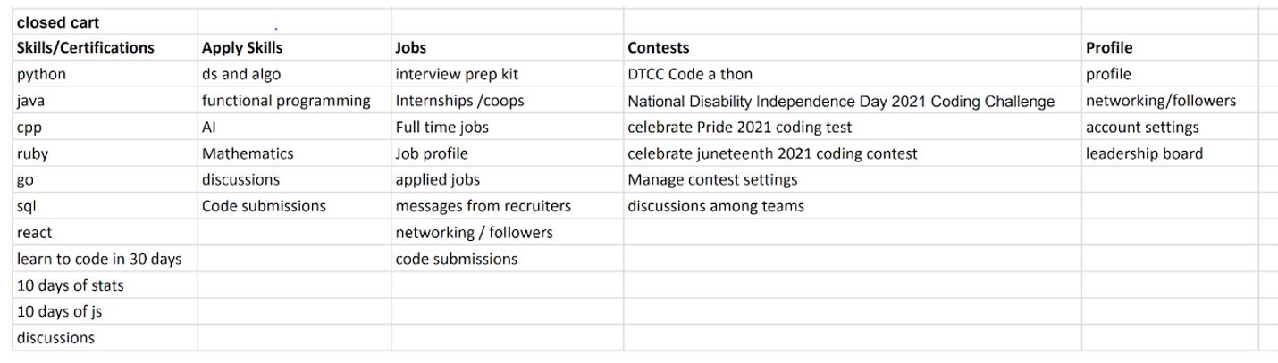
Closed Card Sorting
We can efficiently test the existing structure
Verification if our categories are listed properly
Understand user

Slide 20
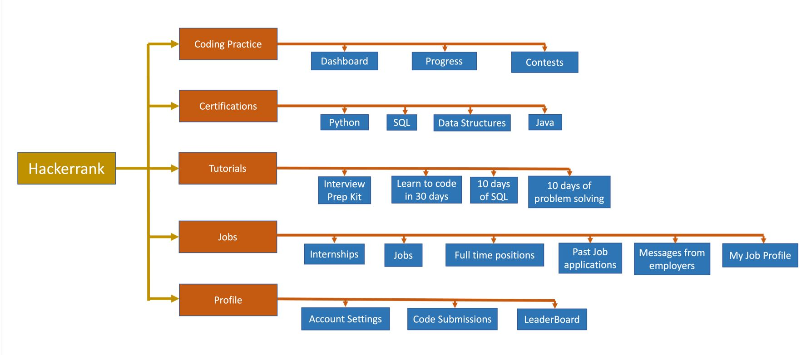
Site Map

Slide 21
Functional Requirements

Slide 22
Must-haves
Should-haves
IDE like environment
Hackerrank sign in for general users
Categorical problems with solutions
Secure coding challenges for company recruitments
Pricing information readily available for a company/college user
Customer Support
SSO functionality to allow user authentication to set tests
General user progress in profile section
Profile integration with Github, LinkedIn, Quora and the like
Discussions for specific problems/coding challenges
Settings for notifications

Slide 23
Could-haves
Won’t-haves
Tutorial support for general users
Certification support for users based on experience and profile (developer, analyst)
Hackathon events
Company recruitment drives
Leaderboard for coding challenges
Recommendations for reading material after taking practice tests.
Publication of accomplishments on Github, LinkedIn or other similar networking sites.
Career fairs
Coding lessons for young developers

Slide 24
Usability Testing

Slide 25
Usability Testing
A usability test is how UX researchers evaluate how easy or difficult a task is to complete.
Usability tests can be split into two categories: Qualitative and Quantitative
Qualitative tests: see how test participants engage with specific UI elements to determine which components are problematic.
Quantitative tests: assessment of the UI design, either based on participants’ performance of tasks

Slide 26
Color Scheme

Slide 27
Color Palette
#f2f2f2
#39603 (forest)
#FFFFFF or #000000
#D9001B
Header-background, secondary buton background
Primary Color, Primary Button background, Main Headings
Rest of the written material
External links - SSO Login

Slide 28
Summary - Meeting the elements

Slide 29
Five Planes of User Design
Strategy
Scope
Structure
Skeleton
Surface
Functional and content requirements
Interface and Navigation design
User needs and product objectives
Interaction design and information architecture
Sensory design

Slide 30
References
Scenarios: https://methods.18f.gov/decide/user-scenarios/
UX Research: https://www.nngroup.com/articles/which-ux-research-methods/
Personas: https://www.nngroup.com/articles/persona/
System Usability Testing: Research Collective , Adobe - Ideas
Parallel Design : https://www.nngroup.com/articles/parallel-design/

Slide 31
DEMO

Slide 32
Thank you!

